Slide 1

Multi-Texture Building Surface Crack Detection
Using Vision-Based Deep Learning
and Interpretability Techniques
George Priji Promod
Under the Guidance of
Reg. No: MBT24CSCE04 / M24CS1003
Dept. of Computer Science & Engineering
Mar Baselios College of Engineering
and Technology (Autonomous)
Dr. Anne Dickson
Associate Professor
Dept. of CSE, MBCET
Mar Ivanios Vidyanagar, Thiruvananthapuram - 695 015 | April 2026

Slide 2
Agenda
01 Introduction
11 Severity Analysis Pipeline
02 Problem Statement & Objectives
12 Severity Levels
03 Literature Review
13 Qualitative Results
04 Dataset
14 Quantitative Results
05 System Architecture
15 Conclusion
06 Preprocessing & Mask Generation
16 Future Work
07 Model: Segmentation & U-Net
17 References
08 Attention U-Net Architecture
09 Training Setup
10 Training Results
Multi-Texture Building Surface Crack Detection | George Priji Promod

Slide 3
Introduction
Background & Motivation
Concrete structures form the foundation of modern civil infrastructure; surface cracks are among the earliest indicators of structural deterioration, often preceding catastrophic failure if left undetected.
Conventional manual inspection is time-intensive, subjective, and hazardous, making it impractical for large-scale or high-frequency structural monitoring.
Classical image processing techniques — edge detection, thresholding, morphological operations — exhibit limited robustness across varying surface textures, lighting conditions, and crack geometries.
There exists a compelling need for an automated, scalable, and texture-aware system capable of precise crack localisation and quantitative severity assessment across multi-texture building surfaces.
Multi-Texture Building Surface Crack Detection | George Priji Promod

Slide 4
Problem Statement & Objectives
Problem Statement
Existing crack detection systems fail to address the combined challenges of multi-texture surface variability, absence of pixel-level segmentation masks, and lack of quantitative severity grading — rendering them insufficient for real-world structural health monitoring of concrete buildings.
Objectives
1
To study and understand the fundamentals of deep learning, image segmentation, and convolutional neural networks as a foundation for addressing crack detection in concrete structures.
2
To design and train an Attention U-Net model for pixel-level crack segmentation, including generation of pseudo ground-truth masks using Frangi ridge filter in the absence of annotated datasets.
3
To implement a quantitative severity assessment pipeline that classifies detected cracks into five levels — None, Low, Medium, High, and Critical — enabling actionable structural health monitoring.
Multi-Texture Building Surface Crack Detection | George Priji Promod

Slide 5
Literature Review (1 of 3)
Paper & Author
Method Used
Key Contribution
Limitation
Deep Learning-Based Crack Damage Detection Using CNN
(Cha et al., 2017)
Custom Deep CNN + sliding window technique
Robust under shadows, blur, and varying illumination
Requires large dataset; cannot detect corrosion or spalling
NB-CNN: Crack Detection Using CNN and Naive Bayes Data Fusion
(Chen & Jahanshahi, 2018)
CNN patch detection + Naive Bayes fusion
98.3% hit rate; reduces false positives
GPU dependent; cannot estimate crack geometry
Image-Based Concrete Crack Detection Using CNN and Exhaustive Search
(Li & Zhao, 2019)
Modified AlexNet + exhaustive sliding search
No complex preprocessing; smartphone deployment
High computational cost due to repeated scanning
Multi-Texture Building Surface Crack Detection | George Priji Promod

Slide 6
Literature Review (2 of 3)
Paper & Author
Method Used
Key Contribution
Limitation
Crack Detection in Concrete Using Transfer Learning
(Sharma et al., 2020)
GoogLeNet and ResNet18 transfer learning
Improved accuracy for bridge decks and walls
Weak improvement for pavement images
Crack Detection using Faster R-CNN And Point Feature Matching
(Mohammed et al., 2020)
Faster R-CNN + SURF feature matching
Real-time UAV crack localisation
Lower accuracy compared to classification CNNs
Performance Evaluation of Deep CNN-Based Crack Detection
(Ali et al., 2021)
Custom CNN vs VGG, ResNet and Inception
Fast inference with balanced performance
Cannot measure crack width or orientation
Multi-Texture Building Surface Crack Detection | George Priji Promod

Slide 7
Literature Review (3 of 3)
Paper & Author
Method Used
Key Contribution
Limitation
Crack Detection in Concrete Structures Using Deep Learning
(Golding et al., 2022)
VGG16 + grayscale + edge preprocessing
Grayscale performs similar to RGB
Edge detection removed useful crack features
Concrete Surface Crack Detection with DL Models
(Zadeh et al., 2023)
EfficientNetV2, ResNet50, VGG19
EfficientNetV2 achieved 99.6% accuracy
VGG19 showed weak crack patch performance
Multi-Texture Building Surface Crack Detection | George Priji Promod

Slide 8
Literature Review — Research Gap
What existing studies failed to address:
Most studies focus on single surface types — none address multi-texture building surfaces (walls, decks, pavements) in a unified model.
Existing methods perform image-level classification — none provide pixel-level segmentation masks for precise crack localisation.
No study generates pseudo ground-truth segmentation masks automatically — all require expensive manual pixel-level annotation.
None of the reviewed works include a quantitative severity grading system — crack width, length, area and severity level are not assessed together.
This project addresses all four gaps — Frangi-based mask generation + Attention U-Net segmentation + five-level severity classification pipeline.
Multi-Texture Building Surface Crack Detection | George Priji Promod

Slide 9
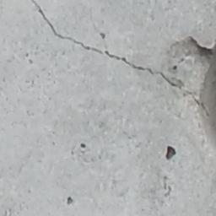
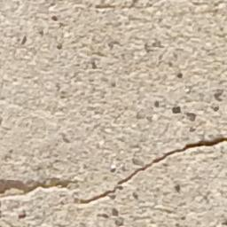
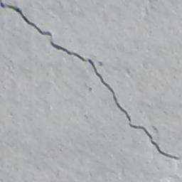
Dataset
SDNET2018 — Structural Defects Network Dataset
Sample Images
Walls
Source: Kaggle — aravindnagarajan/crack-segmentation-dataset
Surface Categories: Walls, Bridge Decks and Pavements
Total Images: 56,092 images across all three categories
Decks
Image Size: Resized to 448 x 448 pixels for model input
Labels: Cracked and Non-Cracked for each surface category
Train / Validation Split: 80% training — 20% validation
Pavements
Test Set: Separate held-out test split for final evaluation
Multi-Texture Building Surface Crack Detection | George Priji Promod

Slide 10
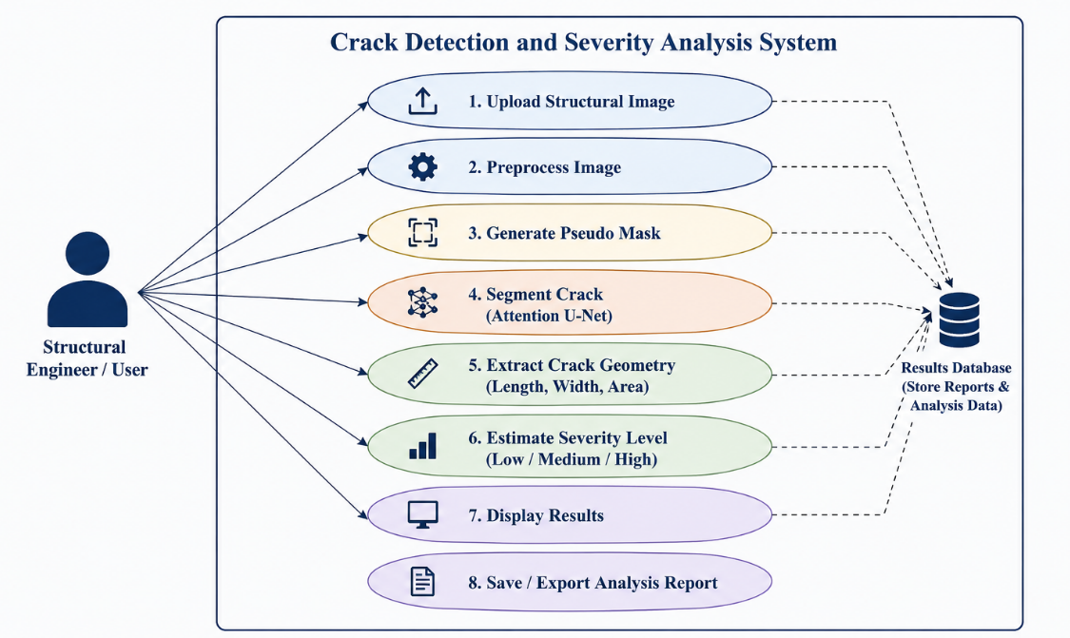
Use Case Diagram
Multi-Texture Building Surface Crack Detection | George Priji Promod

Slide 11
System Architecture
[ Core Model ]
Input
Image
Pre-
processing
Mask
Generation
Attention
U-Net
Crack
Segmentation
Severity
Analysis
Severity
Report
Bilateral Filter
CLAHE
Frangi Filter
Pseudo Labels
Encoder-Decoder
+ Attention Gates
Binary Mask
Output
Crack Ratio
Classification
NONE / LOW
MED / HIGH / CRIT
Input
Prepare
Annotate
Train
Predict
Analyse
Output
Multi-Texture Building Surface Crack Detection | George Priji Promod

Slide 12
Data Flow Diagram
1.
Preprocess
Image
2.
Generate
Pseudo Mask
Legend
User /
Engineer
Raw image
Preprocessed image
External Entity
Process
Data Store
Image data
3.
Attention
U-Net
Pseudo mask
4.
Severity
Analysis
SDNET2018
Dataset
[ Core Model ]
Dataset images
Segmented mask
Severity level
D1: Image
Store
Display &
Export Results
Severity
Report Output
Final report
D2: Results Store
Multi-Texture Building Surface Crack Detection | George Priji Promod

Slide 13
Pseudo Ground Truth Generation Pipeline
Generate pixel-level crack masks from SDNET2018 image-level labels for Attention U-Net segmentation training.
Input Image
Bilateral Filter
CLAHE
Frangi Filter
Morphological
Processing
Connected
Components
Pseudo Crack
Mask
• Frangi Filter enhances thin crack-like tubular structures
• Morphological operations reduce noise and improve crack continuity.
• Connected component filtering removes small false-positive regions.
• Generated pseudo masks are used for Attention U-Net training.
Multi-Texture Building Surface Crack Detection | George Priji Promod

Slide 14
From Classification to Segmentation
CNN Classification
Attention U-Net Segmentation
Crack Image
Output:
Crack /
No Crack
Crack Image
Pixel-Level
Crack
Mask
✖ No crack localization
✔ Pixel-level localization
✖ No geometry extraction
✔ Crack geometry extraction
✖ Weak explainability
✔ Better explainability
✖ Cannot estimate severity
✔ Enables severity analysis
Image Classification → No Crack Localization → Need for Pixel-Level Understanding → Attention U-Net Segmentation
Multi-Texture Building Surface Crack Detection | George Priji Promod

Slide 15
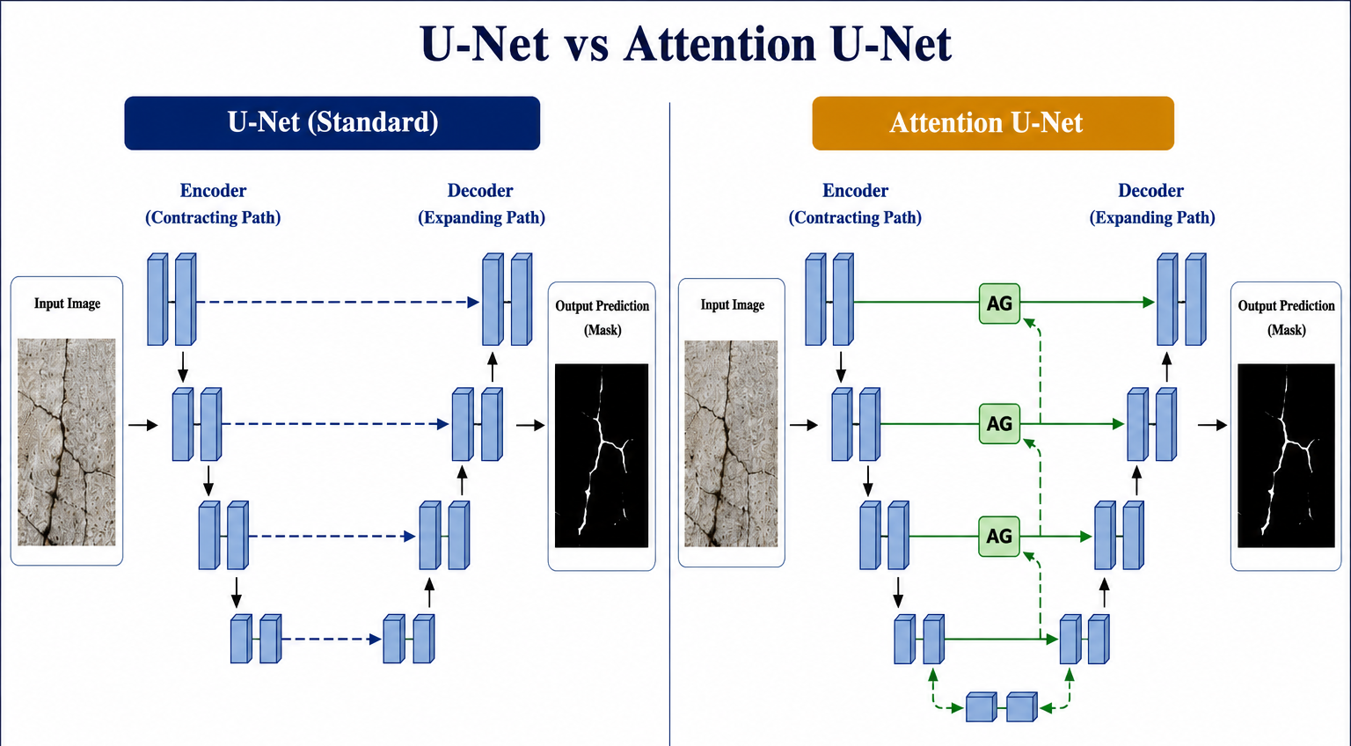
U-Net vs Attention U-Net
Multi-Texture Building Surface Crack Detection | George Priji Promod

Slide 16
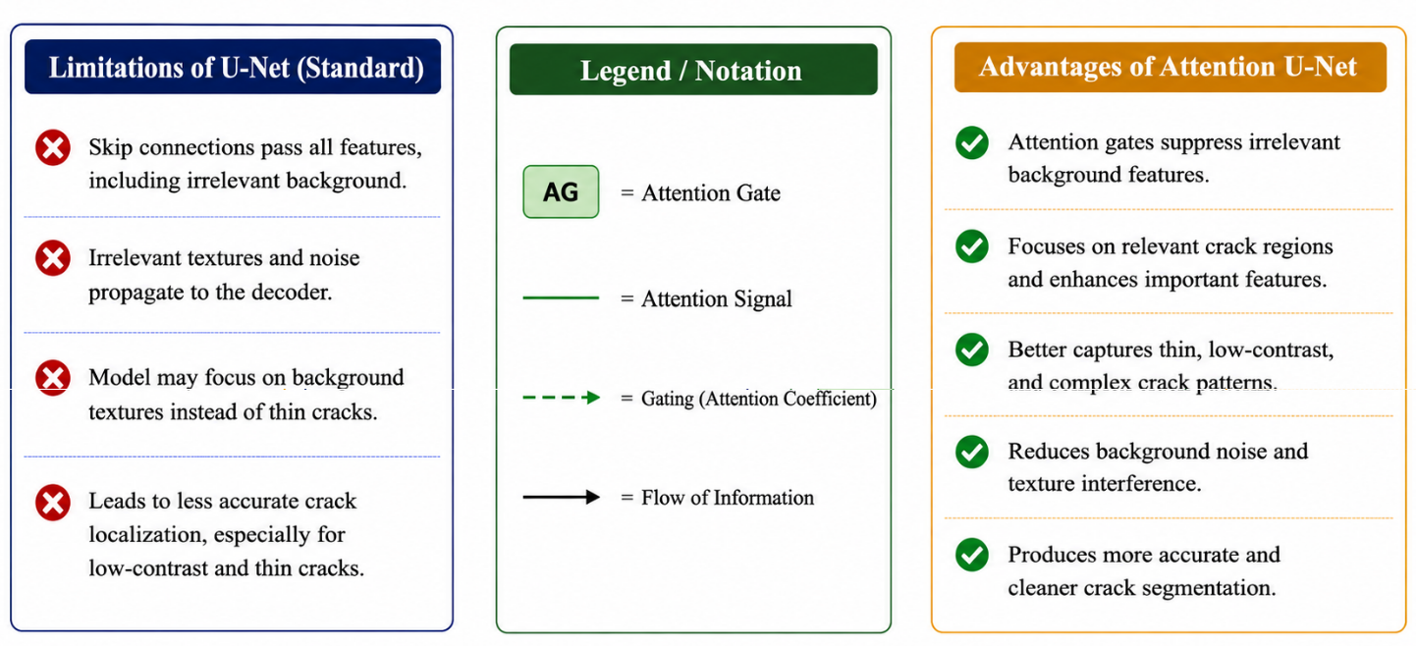
U-Net vs Attention U-Net
Multi-Texture Building Surface Crack Detection | George Priji Promod

Slide 17
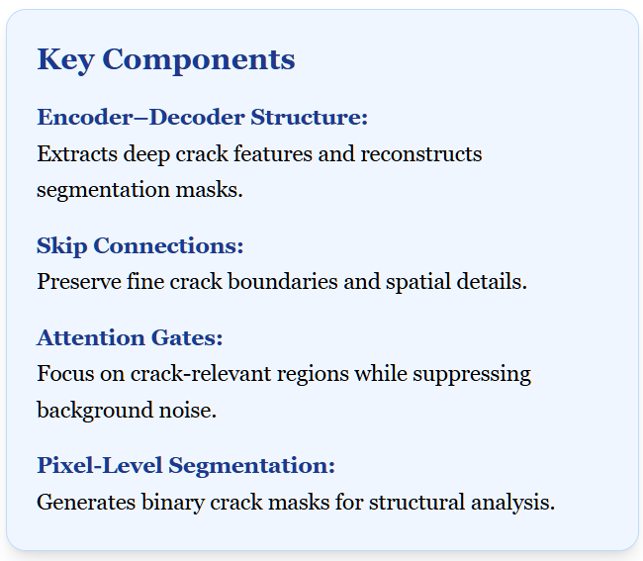
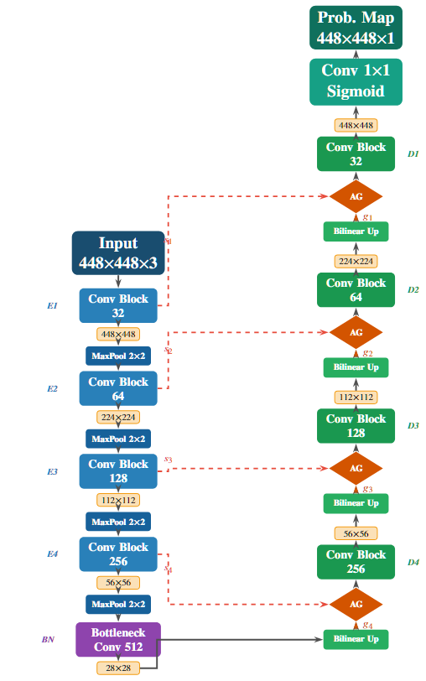
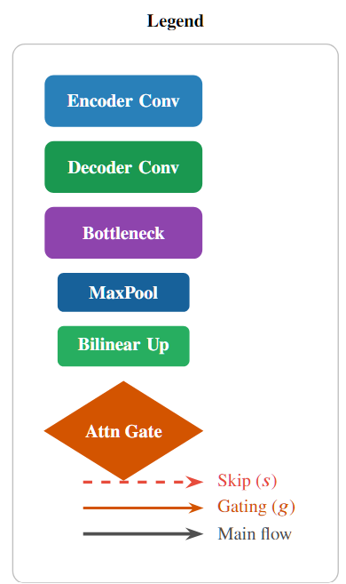
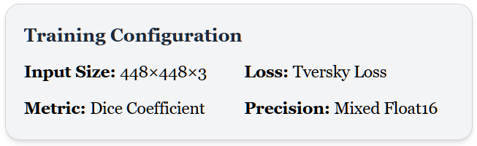
Attention U-Net Architecture
Multi-Texture Building Surface Crack Detection | George Priji Promod

Slide 18
TRAINING FLOWCHART
1. SDNET2018 Dataset
Walls • Decks • Pavements
Training Optimizations
2. Preprocessing
Bilateral • CLAHE • Frangi
EarlyStopping
Prevents overfitting
3. Pseudo Mask Generation
Morphology • Connected Components
4. Image–Mask Pair Creation
Crack Images • Empty Masks
ReduceLROnPlateau
Adaptive learning rate
5. Train / Validation Split
80% Training • 20% Validation
Mixed Float16
Faster GPU training
6. TensorFlow Dataset Pipeline
Resize • Normalize • Batch
7. Attention U-Net Training
Encoder–Decoder • Attention Gates
Adam Optimizer
Stable convergence
8. Tversky Loss + Dice
Handles class imbalance
9. Best Trained Model Saved
Validation Dice = 0.6915
Multi-Texture Building Surface Crack Detection | George Priji Promod

Slide 19
TRAINING SETUP
Configuration Parameters
Optimization & Training Notes
Input Size
448 × 448 × 3
Mixed Precision
Reduced GPU memory usage and enabled faster training.
Batch Size
8
Epochs
30
Tversky Loss
Improved segmentation performance for imbalanced crack pixels.
Optimizer
Adam
Learning Rate
1e-4
Dice Coefficient
Evaluates overlap quality between prediction and mask.
Loss Function
Tversky Loss
Metric
Dice Coefficient
LR Scheduler
Reduced learning rate improved validation stability.
Precision
Mixed Float16
Framework
TensorFlow / Keras
Dice-based optimization is critical because crack pixels occupy only a small region of the image.
Multi-Texture Building Surface Crack Detection | George Priji Promod

Slide 20
SEVERITY ANALYSIS & CLASSIFICATION
Severity Computation Pipeline
Severity Threshold Classification
1. Binary Crack Mask Generated
Severity Level
Crack Area %
Interpretation
NONE
0%
No visible crack
2. Crack Area Percentage Computed
LOW
0.01% – 1%
Minor crack presence
3. Skeletonization Applied
4. Crack Length & Width Measured
MEDIUM
1% – 3%
Moderate propagation
5. Connected Components Counted
HIGH
3% – 7%
Large structural crack
6. Threshold-Based Severity Assigned
CRITICAL
> 7%
Severe infrastructure damage
Crack Area % = (Crack Pixels / Total Pixels) × 100
Multi-Texture Building Surface Crack Detection | George Priji Promod

Slide 21
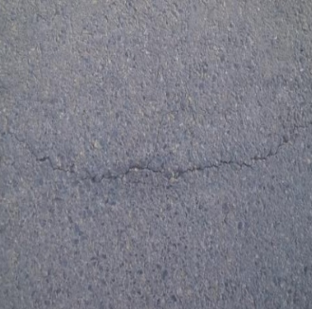
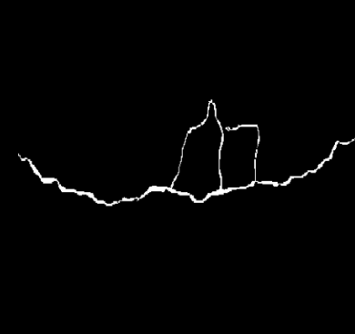
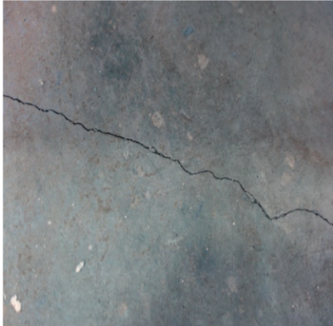
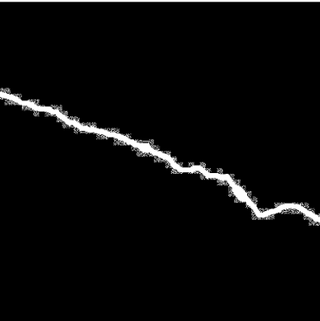
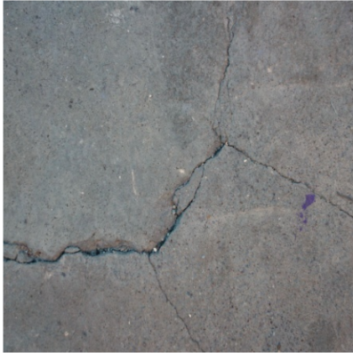
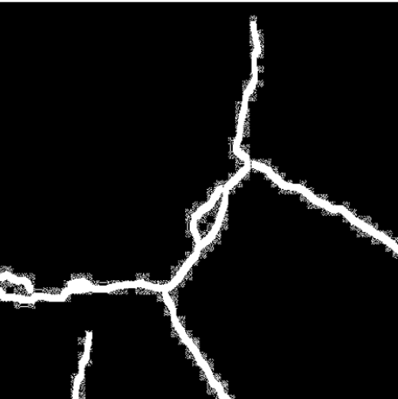
SEVERITY LEVELS
MINOR
MODERATE
SEVERE
Original
Image
Segmentation
Mask
Original
Image
Segmentation
Mask
Original
Image
Segmentation
Mask
Crack Area < 1%
Crack Area 1% – 3%
Crack Area > 3%
• Thin crack
• Localized propagation
• Low branching
• Moderate width
• Visible propagation
• Intermediate density
• Large opening
• Dense crack structure
• Complex branching
Green → Minor Severity | Orange → Moderate Severity | Red → Severe Structural Damage
Multi-Texture Building Surface Crack Detection | George Priji Promod

Slide 22
CONCLUSION
An Attention U-Net based crack segmentation framework was developed for multi-texture building surfaces. The model successfully localized thin crack regions while reducing background texture interference.
Pseudo ground-truth masks generated using OpenCV preprocessing enabled segmentation training without manual annotation. Skeletonization and crack geometry extraction were further used for severity estimation.
Compared to the earlier CNN classification approach (~55% accuracy), the segmentation-based framework significantly improved crack localization capability and was integrated into a Streamlit deployment interface.
Transitioning from classification to segmentation significantly improved crack localization capability.
Multi-Texture Building Surface Crack Detection | George Priji Promod

Slide 23
FUTURE WORK
Potential Future Enhancements
• Use manually annotated crack masks and larger datasets to improve segmentation accuracy and generalization capability.
• Explore Transformer-based and hybrid deep learning architectures for enhanced feature extraction and thin crack localization.
• Optimize the framework for real-time mobile and edge-device deployment for practical infrastructure inspection.
• Integrate the crack analysis system into complete structural health monitoring and smart city maintenance platforms.
Towards scalable AI-driven infrastructure inspection and intelligent structural health monitoring.
Multi-Texture Building Surface Crack Detection | George Priji Promod

Slide 24
References (1 of 2)
[1] S. Dorafshan, R. J. Thomas, and M. Maguire, "SDNET2018: An annotated image dataset for non-contact concrete crack detection using deep convolutional neural networks," Data in Brief, vol. 21, pp. 1664-1668, 2018.
[2] C. Fan et al., "A review of crack research in concrete structures based on data-driven and intelligent algorithms," Structures, 2025.
[3] Y. Nomura, M. Inoue, and H. Furuta, "Evaluation of crack propagation in concrete bridges from vehicle-mounted camera images using deep learning and image processing," Frontiers in Built Environment, vol. 8, September 2022.
[4] Y. Li, "Crack detection and semantic segmentation in concrete structures using an improved deep learning-based framework," Journal of Engineering and Applied Science, vol. 73, p. 107, March 2026.
[5] O. Ronneberger, P. Fischer, and T. Brox, "U-Net: Convolutional networks for biomedical image segmentation," Lecture Notes in Computer Science (MICCAI), vol. 9351, pp. 234-241, 2015.
[6] J. Canny, "A computational approach to edge detection," IEEE Transactions on Pattern Analysis and Machine Intelligence, vol. 8, no. 6, pp. 679-698, 1986.
[7] F. Zhao, Y. Chao, and L. Li, "A crack segmentation model combining morphological network and multiple loss mechanism," Sensors, vol. 23, no. 3, p. 1127, January 2023.
[8] A. F. Frangi, W. J. Niessen, K. L. Vincken, and M. A. Viergever, "Multiscale vessel enhancement filtering," Lecture Notes in Computer Science (MICCAI), vol. 1496, pp. 130-137, 1998.
[9] Y.-J. Cha, W. Choi, and O. Buyukozturk, "Deep learning-based crack damage detection using convolutional neural networks," Computer-Aided Civil and Infrastructure Engineering, vol. 32, no. 5, pp. 361-378, 2017.
[10] S. Li and X. Zhao, "Image-based concrete crack detection using convolutional neural network and exhaustive search technique," Advances in Civil Engineering, vol. 2019, pp. 1-12, 2019.
[11] N. Sharma, R. Dhir, and R. Rani, "Crack detection in concrete using transfer learning," Advances in Mathematics: Scientific Journal, vol. 9, no. 6, pp. 3895-3906, 2020.
[12] F. Chen and M. R. Jahanshahi, "NB-CNN: Deep learning-based crack detection using convolutional neural network and naive bayes data fusion," IEEE Transactions on Industrial Electronics, vol. 65, no. 5, pp. 4392-4400, 2018.
[13] V. P. Golding, Z. Gharineiat, H. S. Munawar, and F. Ullah, "Crack detection in concrete structures using deep learning," Sustainability, vol. 14, no. 13, p. 8117, 2022.
Multi-Texture Building Surface Crack Detection | George Priji Promod

Slide 25
References (2 of 2)
[14] S. S. Zadeh, S. A. Birgani, M. Khorshidi, and F. Kooban, "Concrete surface crack detection with convolutional-based deep learning models," International Journal of Novel Research in Civil Structural and Earth Sciences, vol. 10, no. 3, pp. 25-35, 2023.
[15] O. Oktay et al., "Attention U-Net: Learning where to look for the pancreas," arXiv preprint arXiv:1804.03999, 2018.
[16] K. N. Vankudothu and W. Bukaita, "Quantitative analysis of crack growth and severity in reinforced concrete structures using deep learning and computer vision," American Journal of Traffic and Transportation Engineering, vol. 10, no. 6, pp. 150-167, December 2025.
[17] R. R. Selvaraju, M. Cogswell, A. Das, R. Vedantam, D. Parikh, and D. Batra, "Grad-CAM: Visual explanations from deep networks via gradient-based localization," in Proceedings of the IEEE International Conference on Computer Vision (ICCV), 2017, pp. 618-626.
[18] Wikipedia contributors, "Bilateral filter," https://en.wikipedia.org/wiki/Bilateral_filter, 2024, accessed: 2024.
[19] Analytics Vidhya, "Image contrast enhancement using CLAHE," https://www.analyticsvidhya.com/blog/2022/08/image-contrast-enhancement-using-clahe/, August 2022.
[20] S. S. M. Salehi, D. Erdogmus, and A. Gholipour, "Tversky loss function for image segmentation using 3D fully convolutional deep networks," Lecture Notes in Computer Science (MLMI at MICCAI), vol. 10541, pp. 379-387, 2017.
[21] P. Micikevicius, S. Narang, J. Alben et al., "Mixed precision training," arXiv preprint arXiv:1710.03740, 2018. [Online]. Available: https://arxiv.org/abs/1710.03740
[22] T. S. Tran, S. D. Nguyen, H. J. Lee, and V. P. Tran, "Advanced crack detection and segmentation on bridge decks using deep learning," Construction and Building Materials, vol. 400, p. 132839, 2023.
[23] Z. Zhou, M. M. Rahman Siddiquee, N. Tajbakhsh, and J. Liang, "UNet++: A nested U-Net architecture for medical image segmentation," Lecture Notes in Computer Science (DLMIA at MICCAI), vol. 11045, pp. 3-11, 2018.
[24] K. He, X. Zhang, S. Ren, and J. Sun, "Deep residual learning for image recognition," in Proceedings of the IEEE Conference on Computer Vision and Pattern Recognition (CVPR), pp. 770-778, 2016.
[25] A. Dickson and C. Thomas, "Improved PSO for optimizing the performance of intrusion detection systems," Journal of Intelligent & Fuzzy Systems, vol. 38, no. 1, pp. 547-560, 2020.
Multi-Texture Building Surface Crack Detection | George Priji Promod

Slide 26
THANK YOU
Questions & Discussion
Multi-Texture Building Surface Crack Detection Using Vision-Based Deep Learning and Interpretability Techniques
George Priji Promod
Under the Guidance of Dr. Anne Dickson

